Slide 1


CHESS API
GROUP MEMBERS
23229574-Rahim
23229565-Minh
22229598-Nilasi
GROUP 14

Slide 2

TABLE OF CONTENTS
  INTRODUCTION
  RESEARCH QUESTION 1
  RESEACH QUESTION 2
  CONCLUSION
  REFERNCES

Slide 3

  Chess.com is one of the largest online chess platforms in the world, offering players the ability to play games, solve puzzles, take lessons, and follow tournaments.
  Game Modes: players can choose from several time-control categories that significantly affect the pace and style of play:
BULLET: VERY FAST GAMES.(3 MIN)
BLITZ: FAST GAMES(3-5MIN)
RAPID: MORE TIME PER PLAYER(10+ MIN)
DAILY: MUCH SLOWER (HOURS OR DAYS)

Slide 4
HOW DOES PLAYING WHITE VERSUS BLACK EFFECT THE PROBABILITY OF WINNING ACROSS DIFFERENT CHESS TIME CONTROLS (BULLET, BLITZ, RAPID, DAILY)?
01
  H₀ (Null Hypothesis): The effect of playing White on win probability does not vary by time control.
  H₁ (Alternative Hypothesis): The advantage of playing White differs depending on the time control (e.g., bigger in rapid/classical, smaller in blitz/bullet).

Slide 5
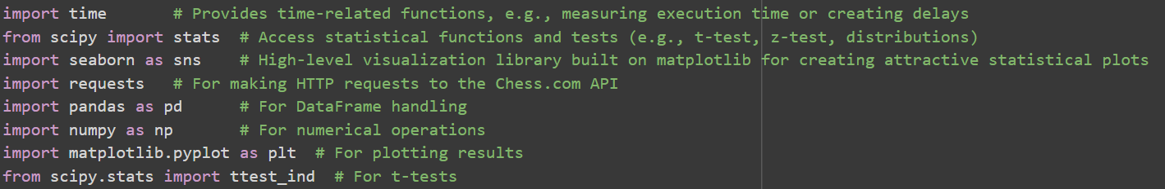
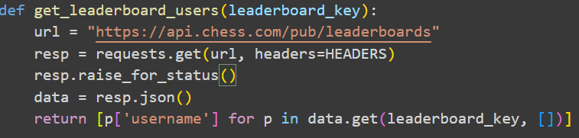
IMPORTS - GETTING THE DATA
Libraries Used:
Pulling the Data
Short code
  HEADERS = {"User-Agent":"MyChessApp/1.0"} → “Identifies our app to the API.”
  get_player_archives(username) → “Gets monthly archive URLs for that user.”
  fetch_games_from_archive(url) → “Downloads that month’s games and returns structured records.”
  df["win"] = np.where(df["result"] == "win", 1, 0) → “Creates a binary win column: 1 = win, 0 = else.”
  df["color"] = np.where(df["color"]=="white", 1, 0) → “Encodes color numerically for analysis.”

Slide 6
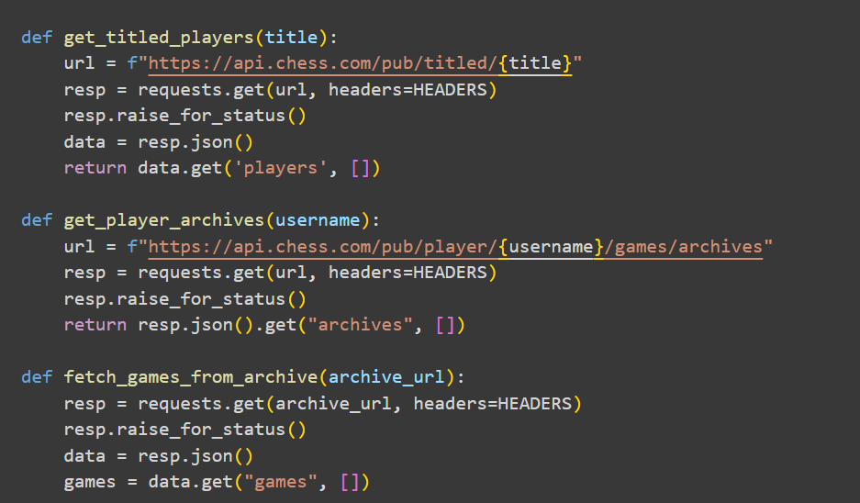
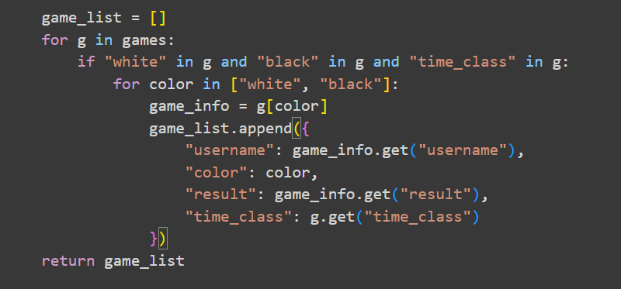
RINSE AND REPEAT:
4

Slide 7
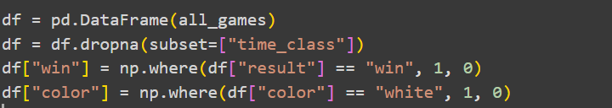
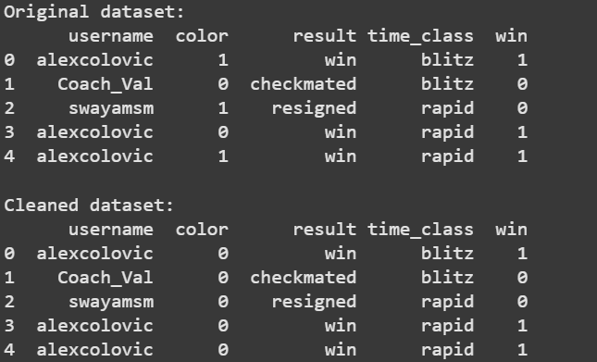
BUILDING AND CLEANING THE DATA:
Old vs Clean
4

Slide 8
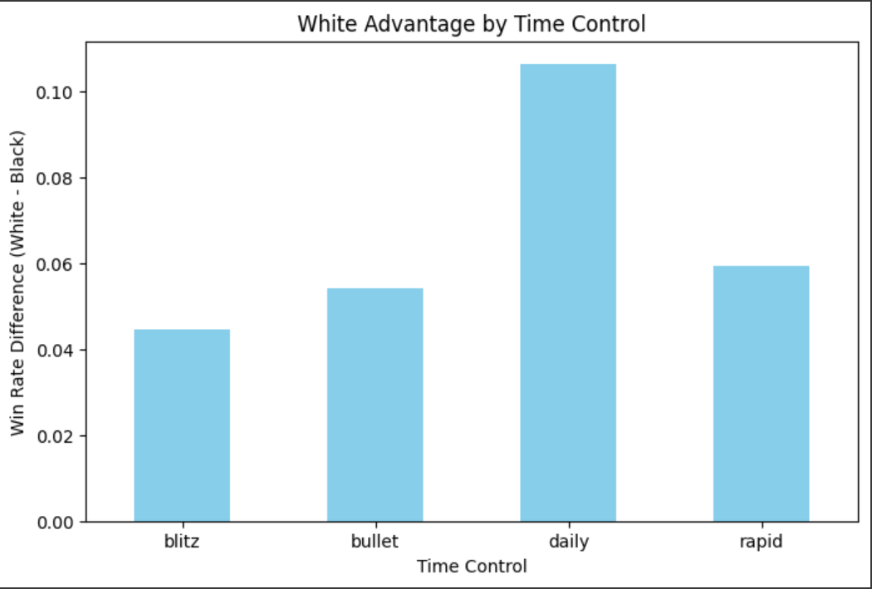
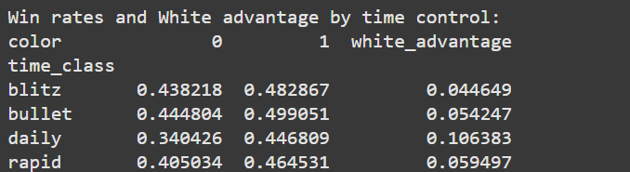
WIN RATES
White Vs Black
4

Slide 9
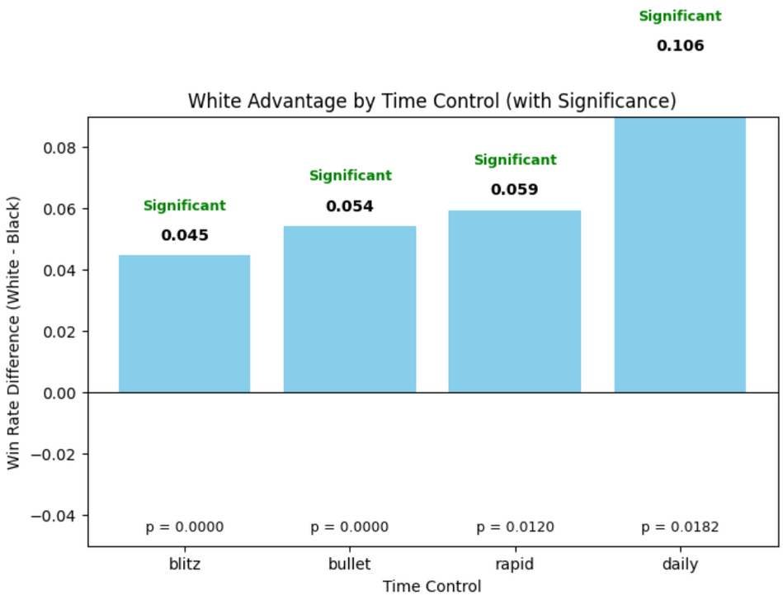
WIN RATES
4
4

Slide 10
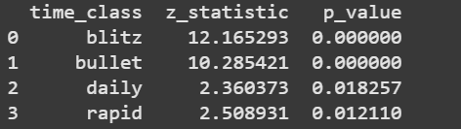
Based on the results of the two-proportion Z-test, there is a statistically significant difference between the win rates of White and Black players across most time controls.
For all formats — blitz, bullet, rapid, and daily — the p-values were below the 0.05 significance level, leading us to reject the null hypothesis (H₀) that both colors have equal chances of winning.
4
4
4

Slide 11
ARE THERE DIFFERENCES IN DRAW RATES FOR BLITZ AND BULLET GAMES?
02
Null Hypothesis: There is no correlation in players having different draw rate in Blitz games and in Bullet games
Alternative Hypothesis: Players have a higher draw rate in Blitz games than in Bullet games
Alternative Hypothesis: Players have a lower draw rate in Blitz games than in Bullet games

Slide 12

IMPORTS - GETTING THE DATA
leaderboard_keys = ['live_blitz', 'live_bullet', 'daily_blitz', 'daily_bullet']
for key in leaderboard_keys:
try:
lb_users = get_leaderboard_users(key)
usernames.update(lb_users)
print(f"Added {len(lb_users)} usernames from leaderboard '{key}'")
except Exception as e:
print(f"Failed to get leaderboard '{key}': {e}")
titles = ['GM', 'IM', 'FM', 'WGM', 'WIM', 'WFM']

Slide 13
CODE SNIPPETS AND CALCULATION
blitz = player_stats.get("chess_blitz", {}).get("record", {})
bullet = player_stats.get("chess_bullet", {}).get("record", {})
blitz_total = blitz.get("win", 0) + blitz.get("loss", 0) + blitz.get("draw", 0)
bullet_total = bullet.get("win", 0) + bullet.get("loss", 0) + bullet.get("draw", 0)
blitz_draws = blitz.get("draw", 0)
bullet_draws = bullet.get("draw", 0)

Slide 14
CODE SNIPPETS AND CALCULATION
df["draw_rate_blitz"] = np.where(
df["blitz_games_played"] > 0,
df["blitz_draws"] / df["blitz_games_played"],
np.nan,
)
df["draw_rate_bullet"] = np.where(
df["bullet_games_played"] > 0,
df["bullet_draws"] / df["bullet_games_played"],
np.nan,
)
df["draw_diff"] = df["draw_rate_blitz"] - df["draw_rate_bullet"]

Slide 15
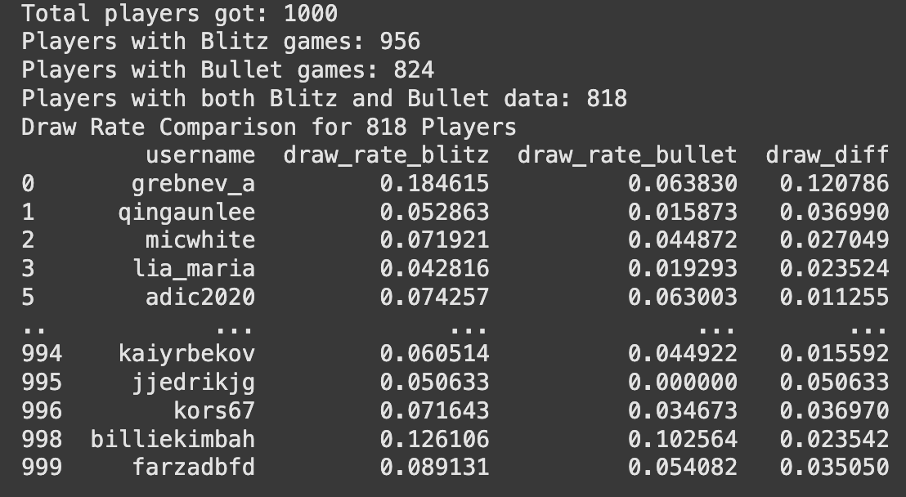
RESULTS

Slide 16
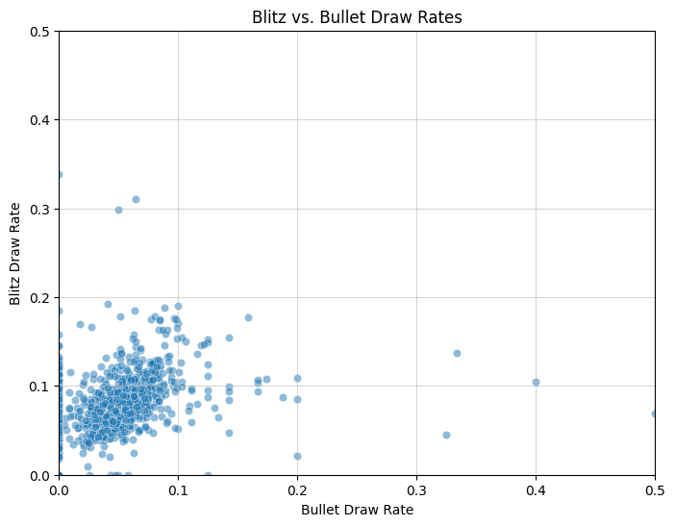
DATA VISUALISATION

Slide 17
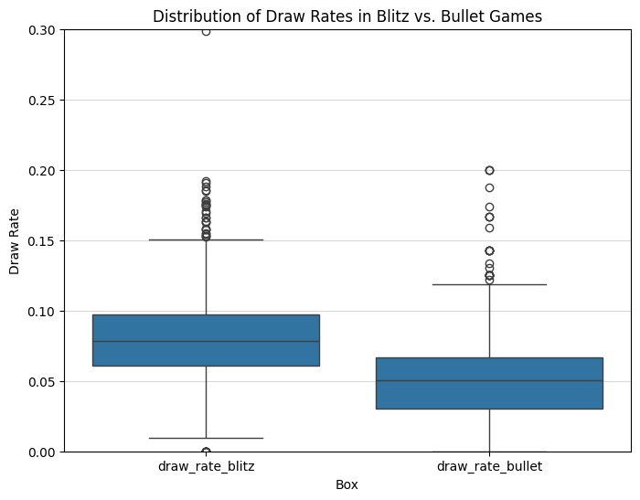
DATA VISUALISATION

Slide 18
RESULTS
  T-test: 12.3649
  P-value: 0.0000000
  Reject the null hypothesis
  → Players have a HIGHER draw rate in Blitz games than in Bullet games.

Slide 19
CONCLUSION
THE FIRST NULL HYPOTHESIS STATED THAT THE EFFECT OF PLAYING AS WHITE ON WIN PROBABILITY DOES NOT VARY BY TIME CONTROL.HOWEVER, THE RESULTS OF THE TWO-PROPORTION Z-TEST REVEALED STATISTICALLY SIGNIFICANT DIFFERENCES BETWEEN THE WIN RATES OF WHITE AND BLACK PLAYERS ACROSS ALL TIME CONTROLS — BLITZ, BULLET, RAPID, AND DAILY. SINCE THE P-VALUES FOR ALL FORMATS WERE BELOW THE 0.05 SIGNIFICANCE LEVEL, WE REJECT THE NULL HYPOTHESIS (H₀) AND CONCLUDE THAT PLAYING AS WHITE HAS A DIFFERENT, AND GENERALLY HIGHER, IMPACT ON WIN PROBABILITY DEPENDING ON THE TIME CONTROL.
THE SECOND NULL HYPOTHESIS PROPOSED THAT THERE IS NO DIFFERENCE IN DRAW RATES BETWEEN BLITZ AND BULLET GAMES. THE T-TEST PRODUCED A STATISTIC OF 12.3649 WITH A P-VALUE OF 0.0000000, WHICH IS FAR BELOW THE 0.05 THRESHOLD. THEREFORE, WE ALSO REJECT THE NULL HYPOTHESIS AND CONCLUDE THAT THERE IS A SIGNIFICANT DIFFERENCE IN DRAW RATES BETWEEN BLITZ AND BULLET FORMATS.

Slide 20
REFERENCES
  TAN, S. (2024, JUNE 5). GETTING CHESS.COM GAME DATA WITH POSTMAN, USE PYTHON AND ANALYZE. MEDIUM. https://medium.com/@stanleytan_4595/getting-chess-com-game-data-with-postman-use-python-and-analyze-48891a502483
  SHEDLOAD OF CODE. (2021, JULY 10). HOW TO SCRAPE AND ANALYSE YOUR CHESS.COM DATA. HTTPS://WWW.SHEDLOADOFCODE.COM/BLOG/HOW-TO-SCRAPE-AND-ANALYSE-YOUR-CHESS-COM-DATA
  CHESS.COM. CHESS API. HTTPS://WWW.CHESS.COM/NEWS/VIEW/PUBLISHED-DATA-API
  BURNS, B. D. (2004). THE EFFECTS OF SPEED ON SKILLED CHESS PERFORMANCE. PSYCHOLOGICAL SCIENCE, 15(7), 442–447. HTTPS://DOI.ORG/10.1111/J.0956-7976.2004.00699.X

